Slide 1
Batch Data Processing Infrastructure
CS 4981 ML Production Systems
RJ Nowling

Slide 2
Data Processing Tasks
Reorganize data sets to enable parallel / distributed processing
Clean data sets
Join / combine data sets
Identify events for labeling records
Compute aggregations (e.g., number of page views per day)
Extract data into new variables (e.g., street names from addresses)
Pre-process images (crop, rotate, etc.)

Slide 3

Parallel and Distributed Computing
There are two primary reasons to use parallel and distributed computing:
The computation (algorithms) are too slow
The data are too large to fit into memory
For data engineering, we are primarily dealing with the case of data being too large to fit into memory on a single machine

Slide 4
Parallel and Distributed Computing
Parallel computing: using multiple processors on a single machine (CPU, GPU, etc.) at once
Fast communication
Distributed computing: using multiple machines
Communication across machines is slower

Slide 5
Big Data
Machine learning systems tend to use large amounts of data
For example, logs, tabular data sets, images, etc.
Need to be able to access state of data at any point in history (time travel)
Big data refers to infrastructure and practices for processing data sets that are too large to fit in memory on a single machine
You can now get cloud VMs with 2+ TBs of memory so that line is shifting constantly ☺

Slide 6
MapReduce
Distributed computing framework described by Jeffrey Dean and Sanjay Ghemawat of Google in a 2004 paper
Goals:
Enable batch processing of data sets too large for a single machine
Use clusters of low-cost, commodity machines
Constrained programming model that enables automatic parallelization
Changed how field thought about and approached data processing

Slide 7

Apache Hadoop
Open-source, Java-based implementation of the MapReduce framework
Started by Doug Cutting (Yahoo!) and Mike Cafarella
Named after a toy elephant owned by Cutting's son
Initial release in 2006

Slide 8
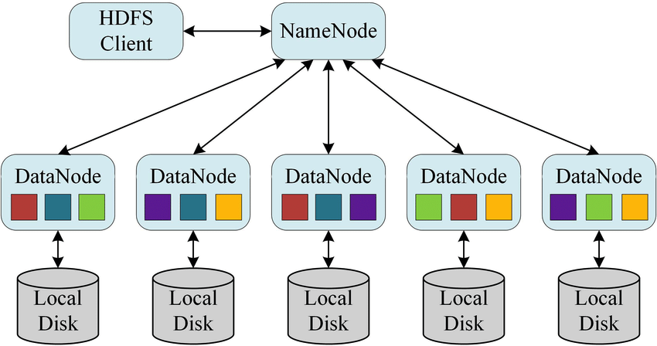
Hadoop Clusters

Slide 9
Hadoop Distributed File System (HDFS)
Each node in the cluster runs a user-land service that manages data on the local disk and provides remote access
A special name node keeps track of where all the data are so that a client can be directed to the appropriate data node
Other services (e.g., Hadoop compute engine) connect to the HDFS services over a network to access data
HDFS only supports write, list, read, and delete operations
Cannot modify files once written -- only delete and rewrite

Slide 10
Programming Model
Each MapReduce job is composed of three stages
Map
A user-provided function is called on each input record
The function outputs a key-value pair
Shuffle
The key-value pairs are grouped together based on keys
Creates a pair of (key, List<value>) with all of the values
Reduce
A user-provided function is called on the (key, List<value>) pair
The function outputs another key-value pair

Slide 11
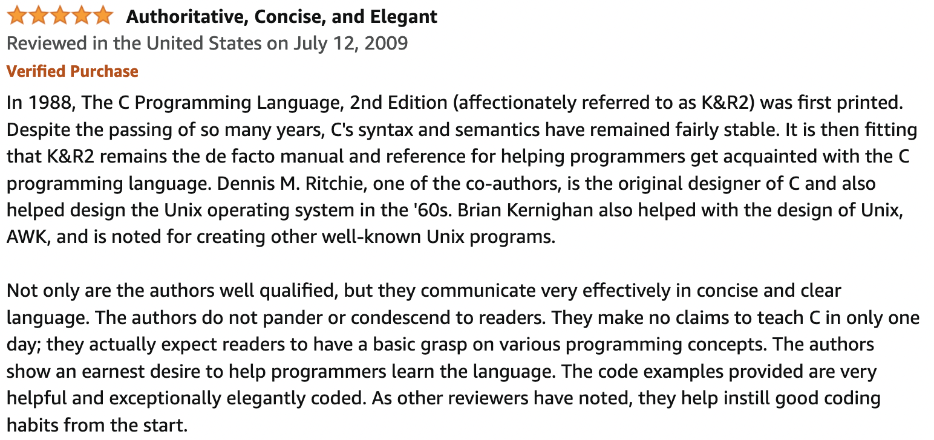
Example: Word Count
Assume the input is a collection of user reviews (text documents)
You want to count how often each word is used (e.g., determining the universe of words (vocabulary) for eventually transforming the documents into vectors

Slide 12
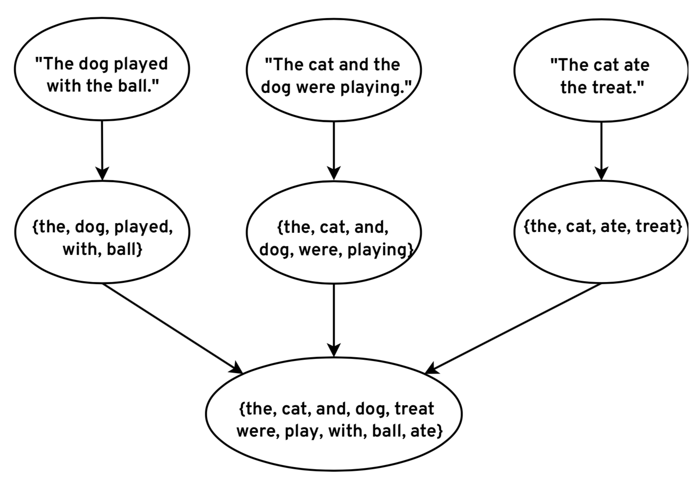
Extract Vocabulary

Slide 13
Word Count Strategy
Mapper will
Take a single text document as a String
Break that document down into words
Return each word as a pair (word, 1)
Reducer will
Take a word and an iterator of word instances (1's)
Sum up the word instances
Return a pair of (word, count)

Slide 14
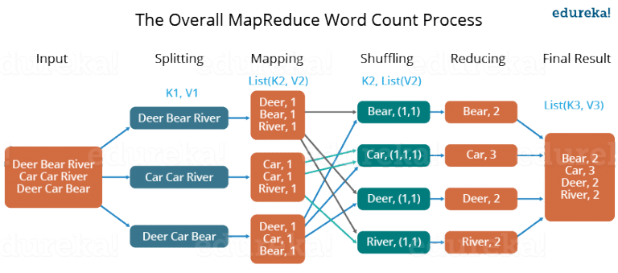
Workflow
https://medium.com/edureka/mapreduce-tutorial-3d9535ddbe7c

Slide 15
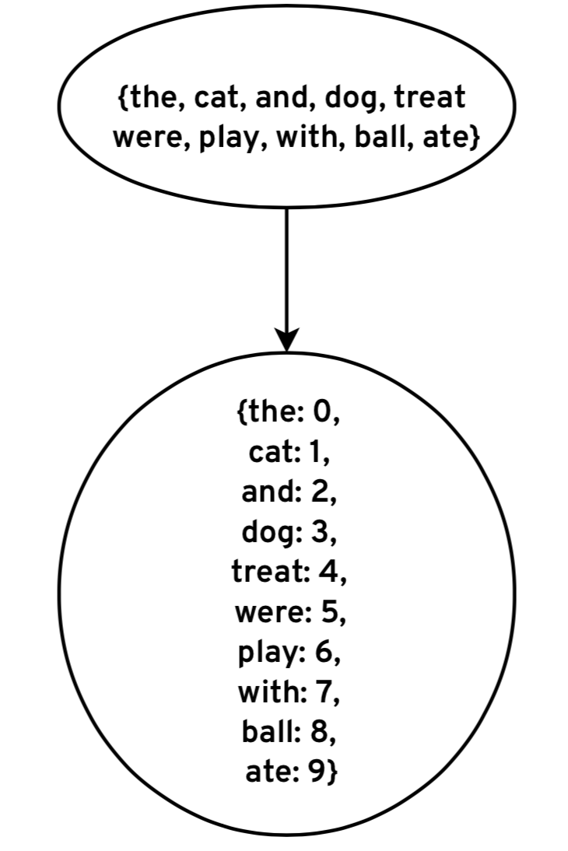
Map Words to Column Indices

Slide 16
Word Indexing
Number of unique words will be relatively small
Hundreds of thousands, maybe millions
Use a single script to generate an index file
aardvark 0
aaron 1
abalone 2
abandon 3
abandoned 4
abandonment 5
abash 6
abashedly 7

Slide 17
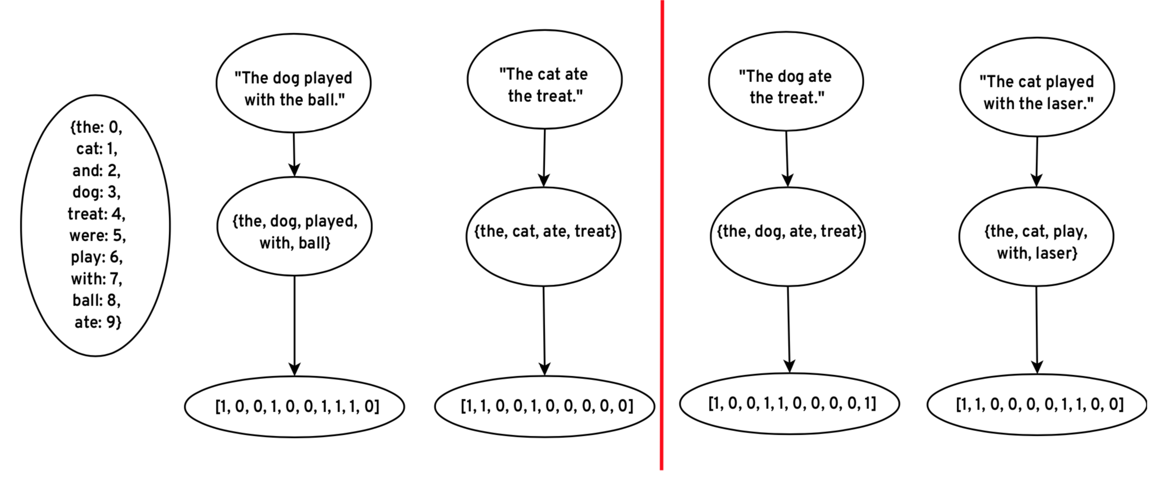
Encode Features

Slide 18
Joins with MapReduce
Mapper #1 will
Tokenize documents into words
Return pairs of (word, (document id, count))
Mapper #2 will
Read table of word indices
Return pairs of (word, index)
Reducer will:
Return pairs of (document_id, (word, count))

Slide 19
Union Class
Hadoop expects both mappers to output pairs of the same type
We cannot have mapper #1 output (Text, (long, int)) pairs and mapper #2 output (Text, long) pairs
We get around this by creating a class that implements a "union"
Either wordIndex is null or (documentId and count) are null
public class JoinUnion {
// following may be null
public Long wordIndex;
public Long documentId;
public Int count;
}

Slide 20
Join Result
We ultimately want to return triples of:
document id
word index
count of occurrences
Since Hadoop only allows pairs, we are going to create an object to store the index and counts
public class WordCount {
public long wordIndex;
public int documentCount;
}

Slide 21
Word Count Vectorization Tasks
Mapper #1 will
Tokenize documents into words
Return pairs of (word, JoinUnion(document id, count))
Mapper #2 will
Read table of word indices
Return pairs of (word, JoinUnion(wordIndex))
Reducer will:
Return pairs of (document_id, WordCount(word, count))

Slide 22
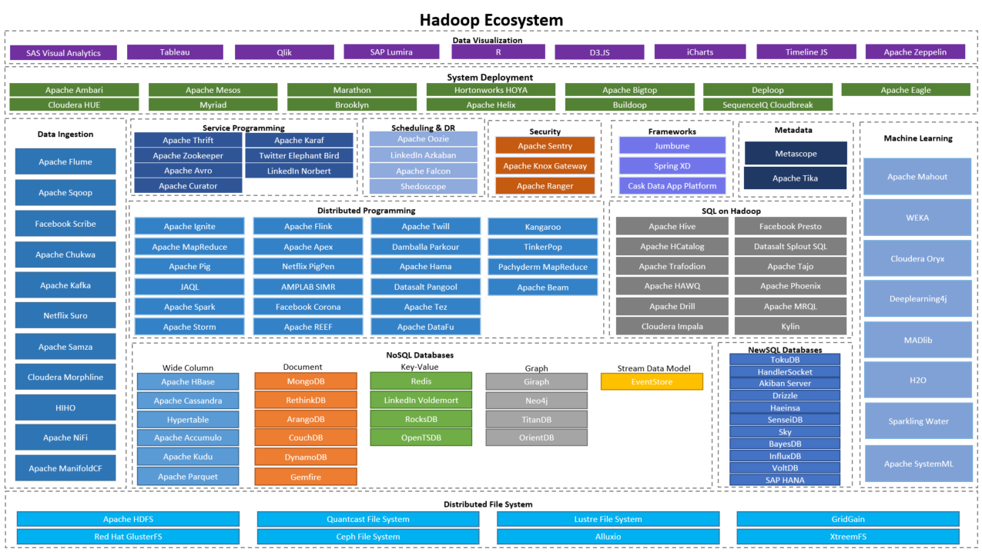
Apache Hadoop Ecosystem
https://mydataexperiments.com/2017/04/11/hadoop-ecosystem-a-quick-glance/

Slide 23

Apache Hive
Writing MapReduce jobs is tedious
SQL is widely used and understood
Idea: enable users to write SQL queries to analyze and transform data
Uses a SQL-like language called HiveQL
Tradeoffs:
Massive parallelism for processing large data sets
Does not support multiple users (avoids all need for locking and consistency)
Tables cannot be updated -- only read and written as a whole (conforms to HDFS semantics)

Slide 24
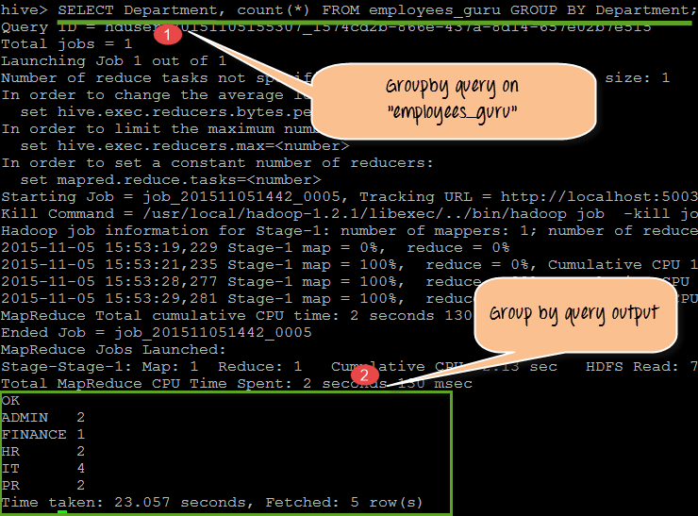
Apache Hive
https://www.guru99.com/hive-queries-implementation.html

Slide 25
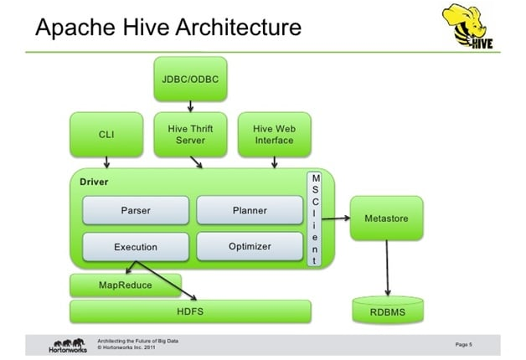
https://intellipaat.com/blog/what-is-apache-hive/

Slide 26

Industry Organization and Collaboration

Slide 27
Scalability
Advantages
Disadvantages
Scalable to large clusters (1000's of machines) and data sets (PB's)
Enabled a shift from proprietary hardware solutions with limited scalability and high costs to clusters of low-cost, generic machines
Reads and writes data to disk at the end of every stage
not efficient for iterative processes like training ML models
optimized for throughput over latency

Slide 28
Programming Model
Advantages
Disadvantages
Automatically parallelizes and distributes code
No thinking about running independent processes or communication between them
Programming model is restrictive
Complex operations require multi-stage pipelines
Can't easily adapt existing code -- need to rewrite important infrastructure

Slide 29
In the Cloud
Cloud computing uses a pay-for-use model
Not cost efficient to keep compute instances running 24x7
Shutting down instances means potential data loss with HDFS
Apache Hadoop now frequently used with object stores (Amazon AWS S3)
Data not tied to compute instances
Object storage less expensive
Only start and pay for compute instances when actively running pipelines

Slide 30

Apache Spark
Started by Matei Zaharia and other Ph.D. students at UC Berkeley in 2009
Open-sourced in 2010, donated to the Apache Software Foundation in 2013
In 2013, Zaharia and others founded the Databricks company
Provides commercial support and cloud-based solutions (Databricks Cloud) for companies
Supports a number of Apache Spark developers

Slide 31
Key Idea: Keep Data in Memory
Whereas Apache Hadoop writes data to permanent storage after the completion of each Map-Reduce stage,
Apache Spark keeps data in memory on the compute nodes while the pipelines are running
Data read at the beginning of the pipeline and written at the end
Much more efficient for pipelines with many stages and iterative processes
Less scalable -- typical clusters have 100's of nodes, working on data sets that are too large to fit into memory are challenging to work with

Slide 32
Resilient Distributed Datasets
Dataset: An unordered collection of objects
Distributed: The data are located across nodes in a cluster, but the API is similar to a local Java Collection
Resilient: Tracks history of operations starting with the original input source so that parts of the dataset can be rebuilt if a node fails

Slide 33
Resilient Distributed Datasets
Methods for an RDD<T> include:
RDD<U> map(Function<T, U> f): Executes the function on each object in the RDD and returns a new RDD of the resulting objects
RDD<T> filter(Function<T, boolean> f): Executes the function on each object in the RDD and discards objects for which the function returns false
RDD<T> distinct(): Removes duplicate objects
RDD<Pair<T, U>> reduceByKey(Function<U, U> f): Similar to the reduce functionality of mapReduce

Slide 34
Resilient Distributed Datasets
RDDs with key-value pairs of have additional methods:
RDD< Pair<U, Iterable<T>>> groupBy(Function<T, U> f): The function f extracts a key of type U from each object and groups all objects with the same keys into iterables
RDD<Pair<T, U>> reduceByKey(Function<U, U> f): Similar to the reduce functionality of mapReduce

Slide 35
Resilient Distributed Datasets
A Spark program can have multiple RDDs. Operations on pairs of RDDs include:
Joins: Inner, Full Outer, Left, Right
Cartesian product: every possible pair formed from objects into the two RDDs
Intersection: select common objects in two RDDs
Union: Combines two RDDs into a single RDD

Slide 36
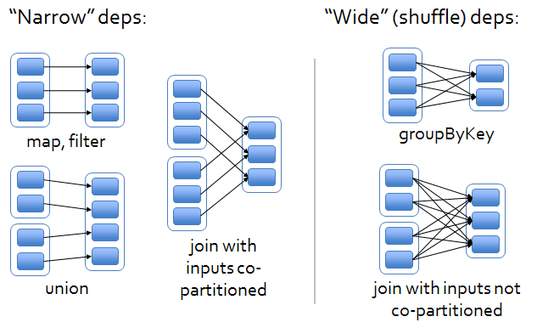
Shuffles
https://medium.com/@dvcanton/wide-and-narrow-dependencies-in-apache-spark-21acf2faf031

Slide 37
Laziness
RDD operations are lazy
RDDs queue up the operations until an "action" operation is requested:
save to a file
count the objects
summarize information
This allows Spark to combine sequential operations to reduce overhead

Slide 38
Datasets
Datasets are a new type of collection
They use laziness to achieve even more efficiently
Queued operations are run through a "query planner" (much like SQL)
Operations may be re-ordered (when safe) to make them more efficient
For example, let's say you specify a join operation followed by a filter operation
The query planner will check if the filter can be performed first to reduce the number of objects that need to be shuffled for the join

Slide 39
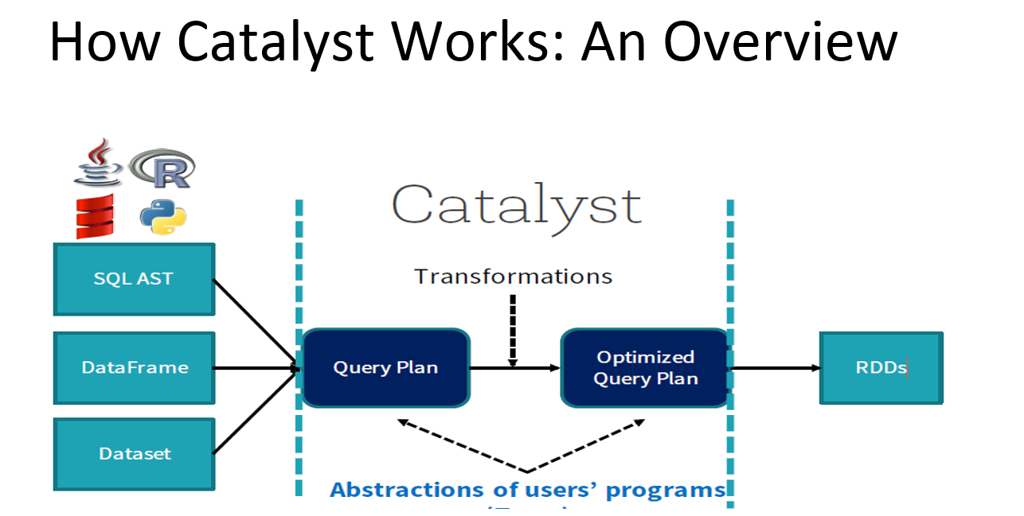
DataSets
https://medium.com/@Shkha_24/catalyst-optimizer-the-power-of-spark-sql-cad8af46097f

Slide 40
DataFrames
Tabular data
Dataset of Row objects
Provide operations similar to a Pandas DataFrame

Slide 41
Spark SQL
Spark can execute SQL statements on DataFrames
Provides online analytics processing (OLAP) capabilities
Does not support multiple users, enables for very high levels of parallelization
Data kept in memory
Queries generally run much faster than in a SQL database which is limited to one core per connection
Spark supports connecting to traditional SQL databases and performing parallel reads of tables
Pattern: extract the table, do the analytics in Spark, write results to an object store

Slide 42
Low-Cost Interchange
Spark SQL statements are run on DataFrames
DataFrames are Datasets of Row objects
Datasets wrap RDDs
Everything is really an RDD
Multiple APIs can be used within a single program at low cost
Use the API that makes the desired operation as easy as possible

Slide 43
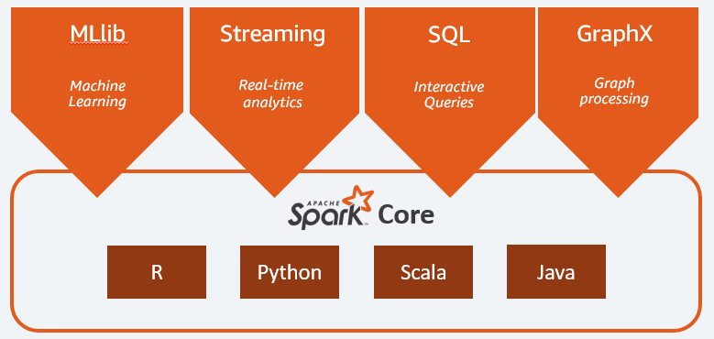
All-in-One Solution

Slide 44

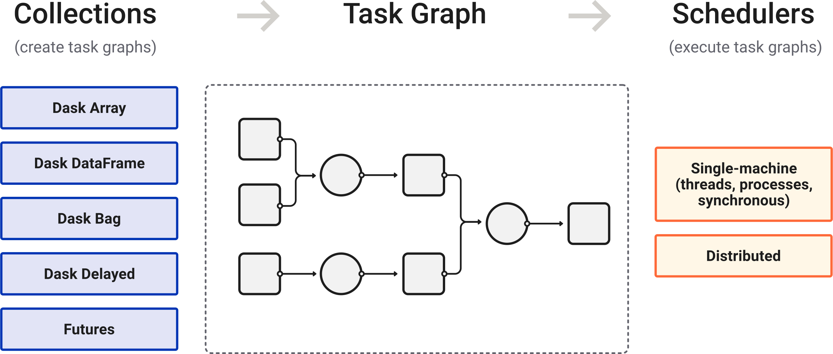
Dask
https://docs.dask.org/en/stable/

Slide 45
War Story: Not Invented Here

Slide 46
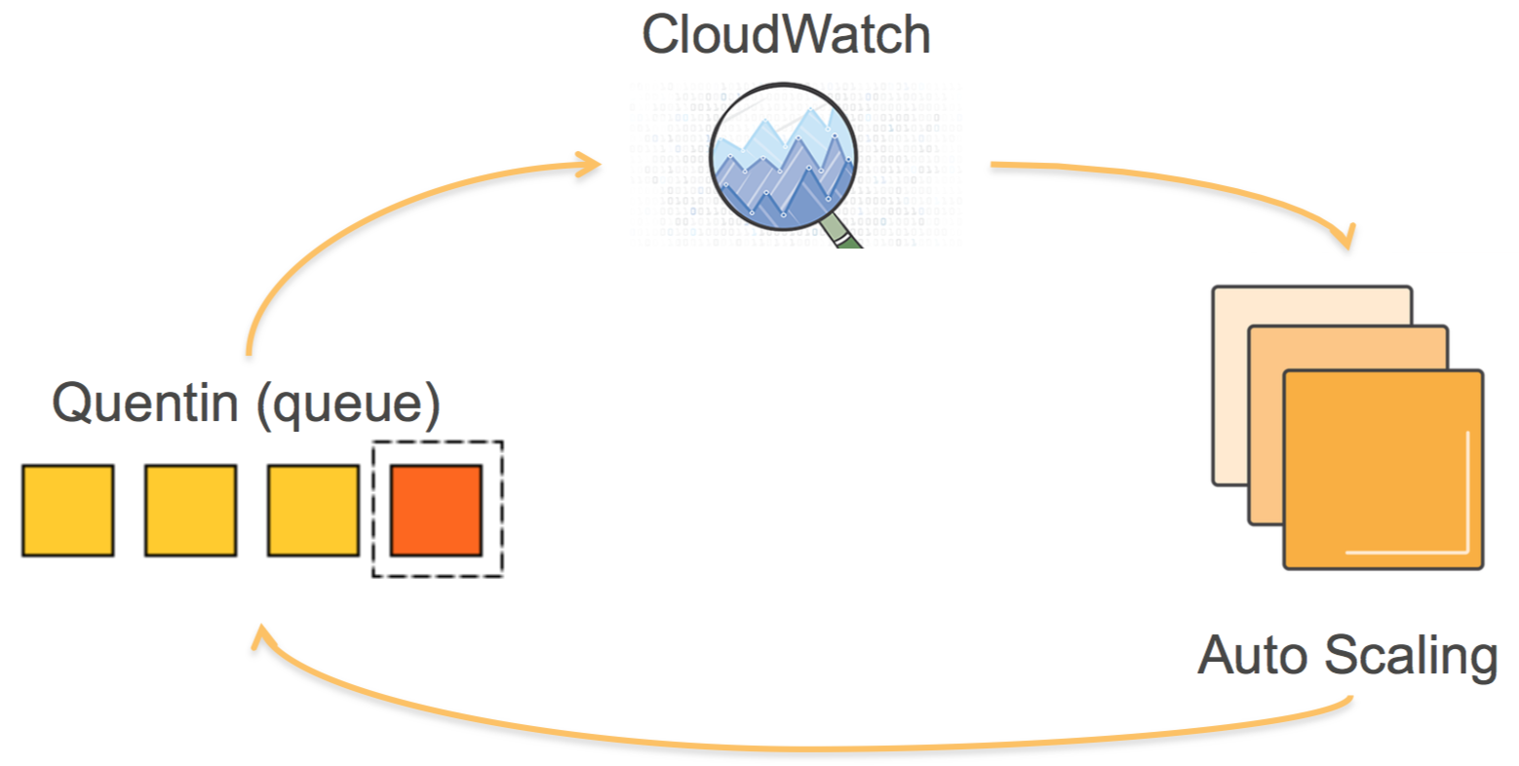
War Story: Not Invented Here
https://tech.nextroll.com/blog/data/2015/10/15/luigi.html

